Slide 1
SIMPLE HOTEL MANAGEMENT PROJECT IN PYTHON
MODULES:
Client Service In
Room Service
View Occupied Room Details
Check out
PYTHON CONCEPTS:
Dictionary Data Structure
Datetime Module
OOP-Class and Objects

Slide 2
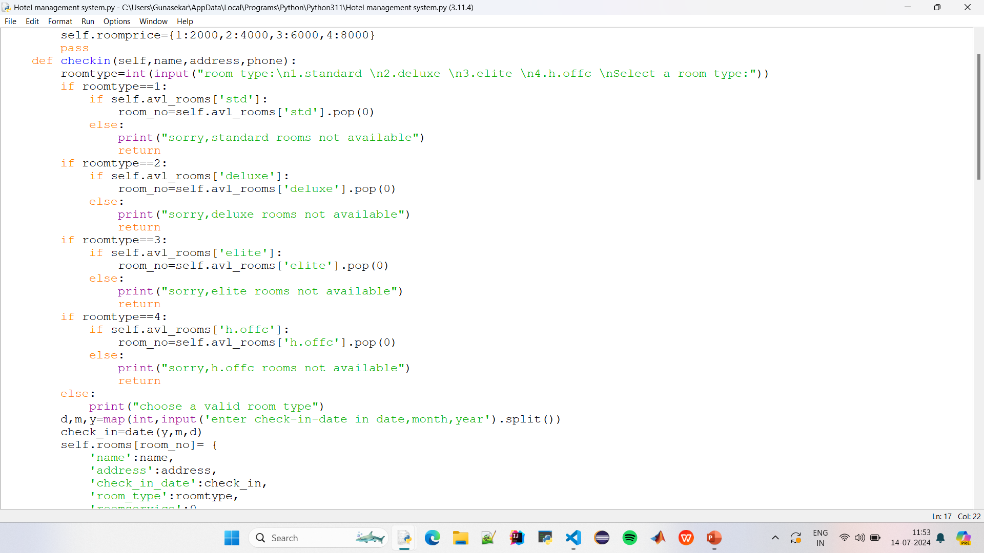


Slide 3
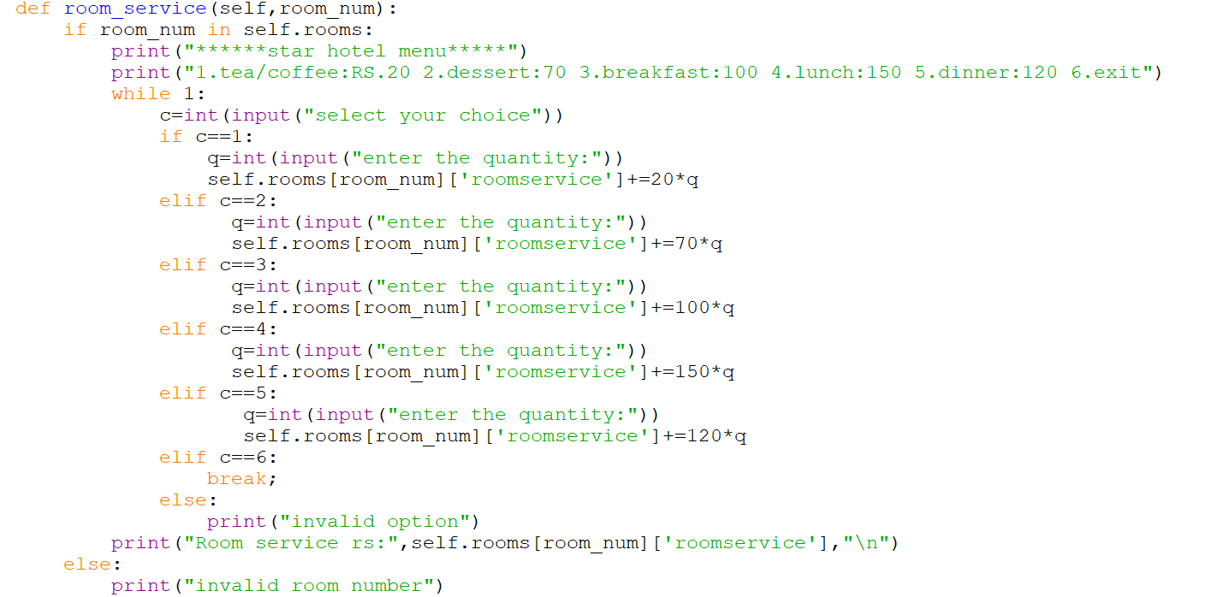

Slide 4


Slide 5
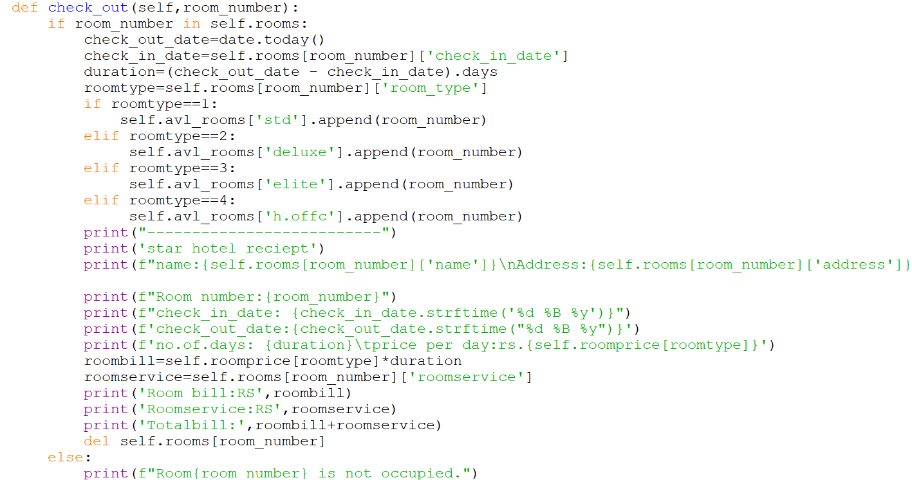

Slide 6
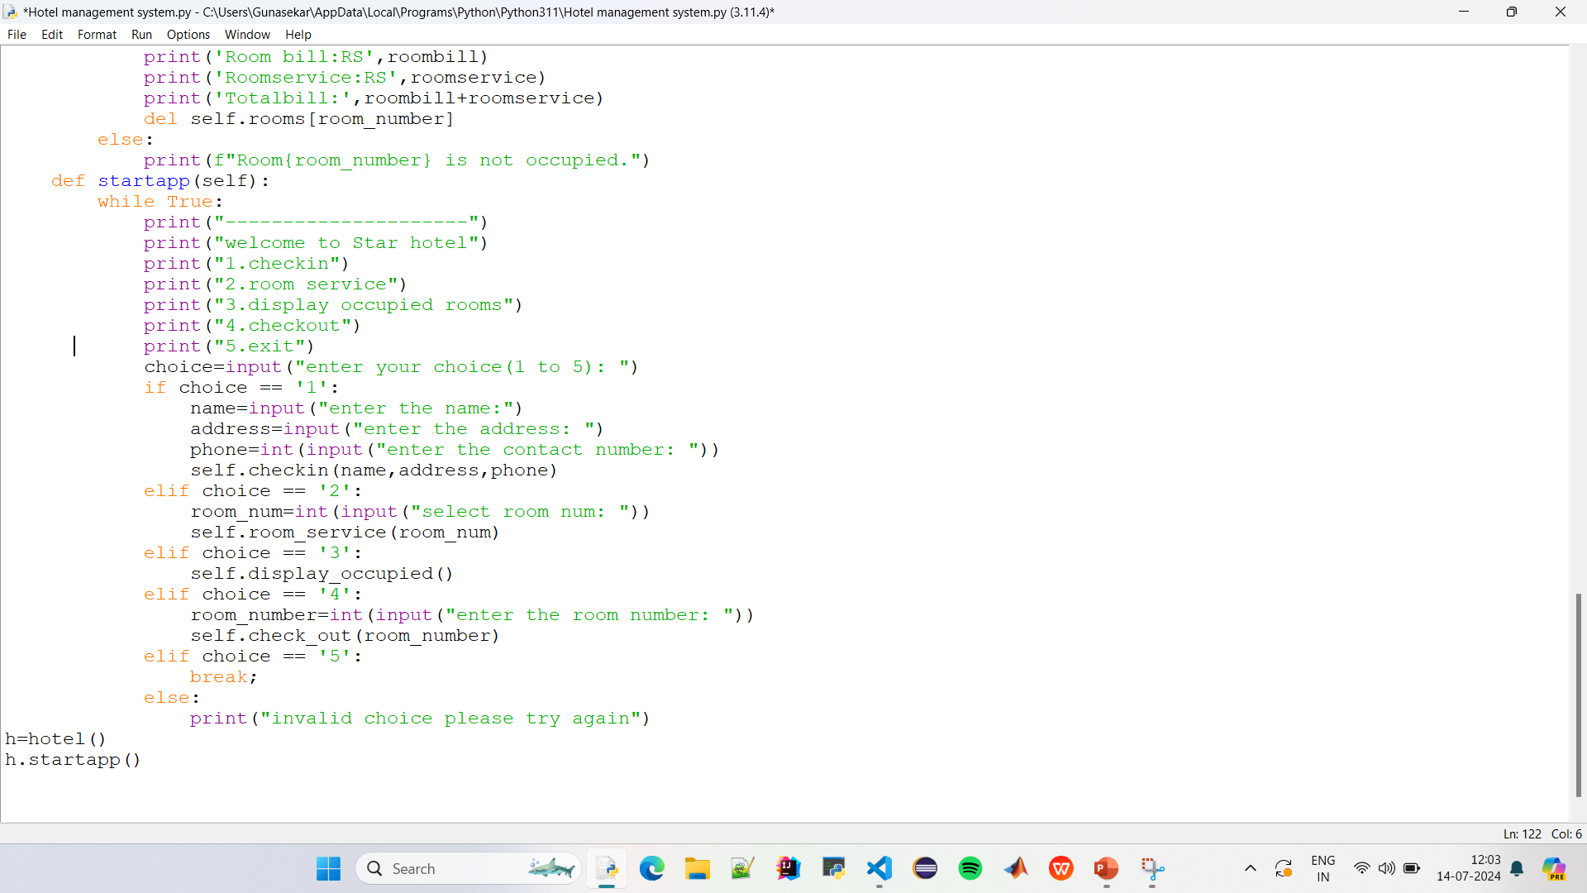

Slide 7
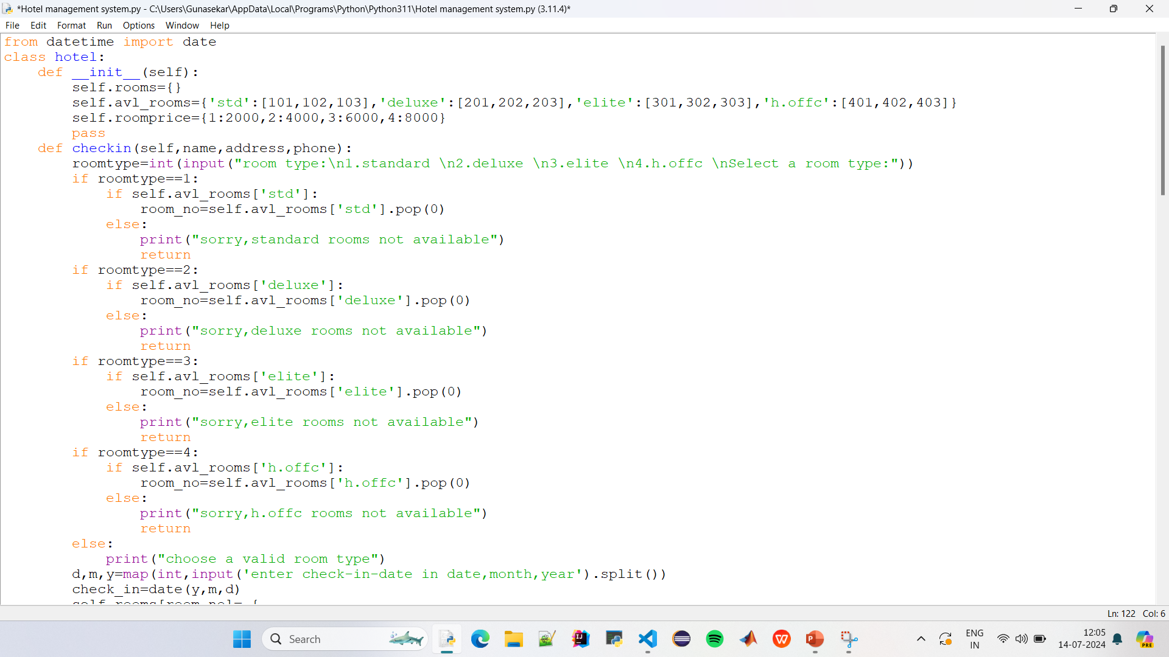

Slide 8
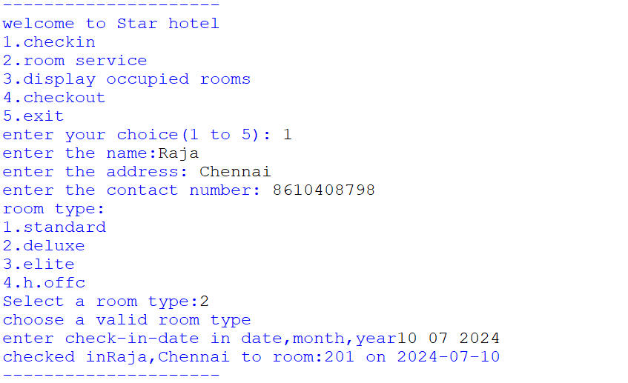


Slide 9
